Slide 1
Phishing Awareness Training
Understanding, Identifying, and Preventing Phishing Attacks
Presented by: Navya Arriboyina
CodeAlpha Cyber Security Internship Project
June 2026

Slide 2
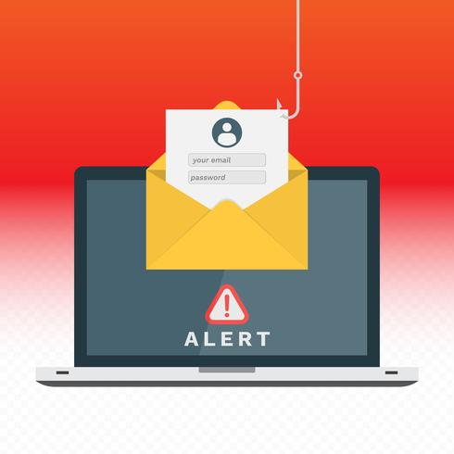
What is Phishing?
Phishing is a cyberattack where attackers pretend to be trusted organizations or individuals to steal sensitive information.
Key Objectives:
• Steal login credentials
• Obtain financial information
• Access personal data
• Spread malware
Common Methods:
• Emails
• SMS Messages
• Fake Websites
• Social Media

Slide 3
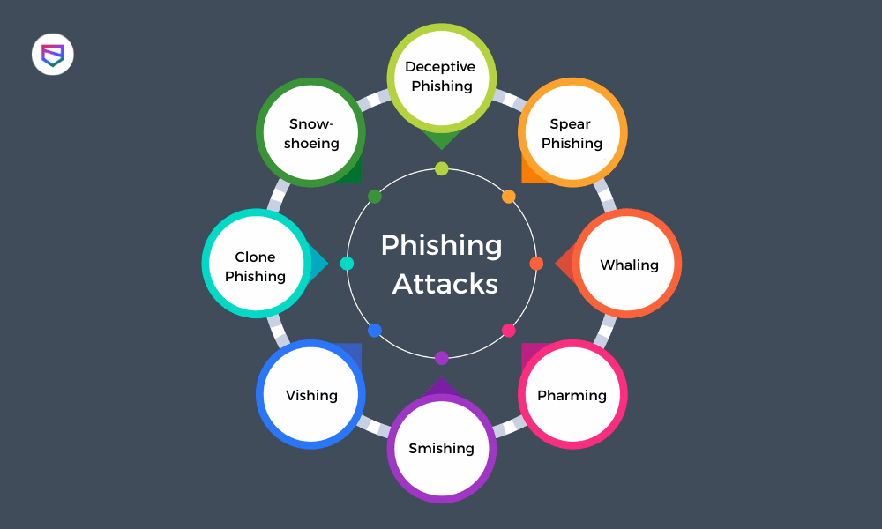
Types of Phishing
Phishing attacks come in different forms, each targeting users in different ways.
• Email Phishing – Fake emails that steal personal or financial information.
• Spear Phishing – Targeted attacks aimed at a specific person or organization.
• Smishing – Phishing attacks carried out through SMS or text messages.
• Vishing – Fraudulent phone calls used to obtain confidential information.
• Clone Phishing – A legitimate email is copied and modified with malicious links or attachments.

Slide 4
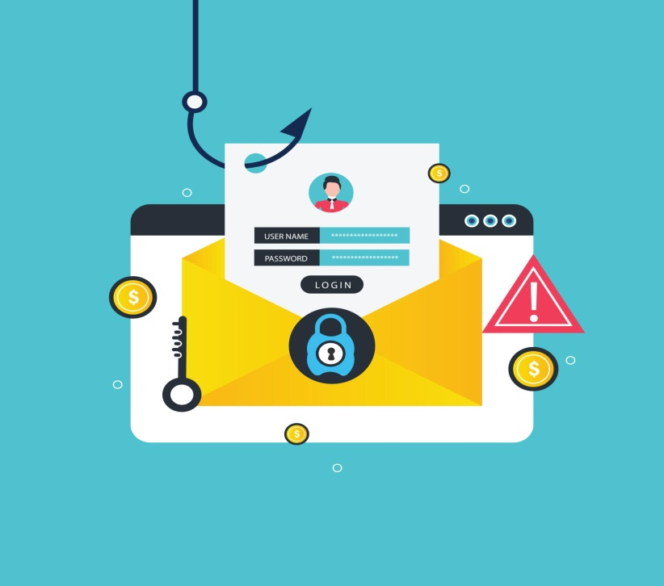
How to Identify a Phishing Email
Phishing emails try to steal your personal information. Before opening or replying to an email, check these warning signs:
• Suspicious sender email address
• Generic greetings (e.g., "Dear Customer")
• Urgent or threatening messages
• Spelling and grammar mistakes
• Suspicious links or attachments
• Requests for passwords or personal details

Slide 5
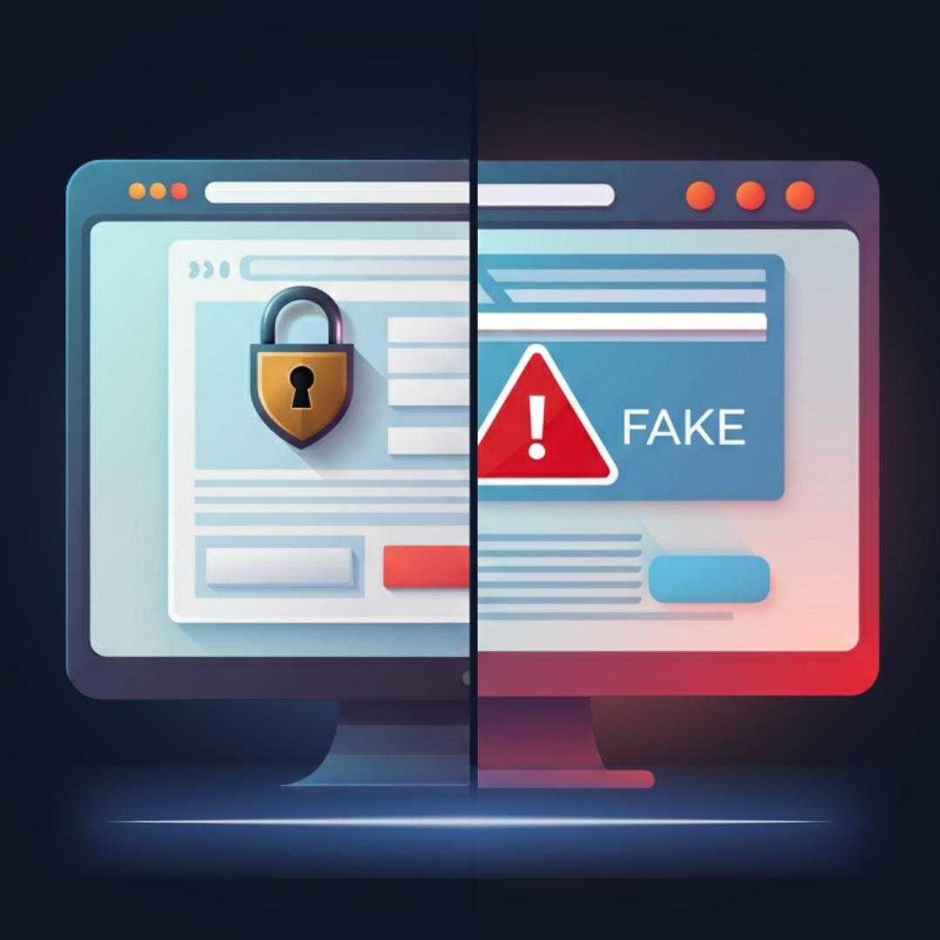
Signs of a Fake Website
Fake websites are designed to steal your personal or financial information. Before entering any details, check these warning signs:
• Misspelled or unusual website URLs
• Missing HTTPS or the security padlock icon
• Poor website design and broken links
• Requests for sensitive information
• Too-good-to-be-true offers or discounts
• Unexpected pop-ups or redirects

Slide 6
Social Engineering Tactics
Social engineering is a psychological manipulation technique used by cybercriminals to trick people into revealing confidential information or performing unsafe actions. Instead of attacking systems, attackers exploit human trust and emotions.
Common Tactics:
• Authority – Pretending to be a manager, bank official, or government representative.
• Fear and Urgency – Creating panic by claiming an account will be blocked or compromised.
• Curiosity – Sending attractive links or attachments to encourage users to click.
• Greed – Offering fake prizes, rewards, or discounts to attract victims.
• Trust Exploitation – Building trust before requesting sensitive information

Slide 7
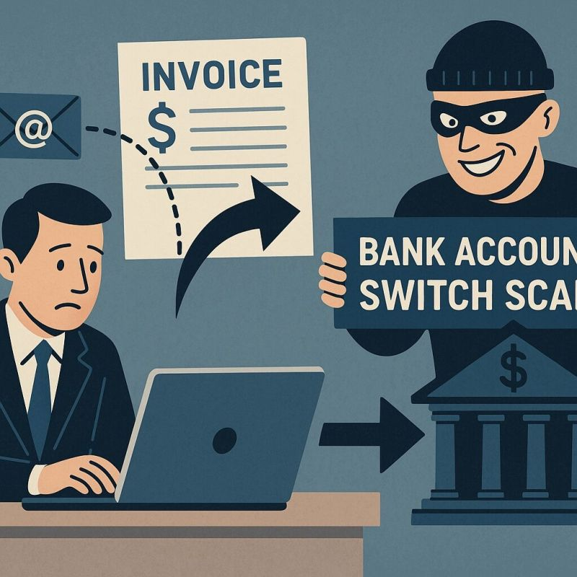
Real-World Example
A user receives an email that appears to be from a bank asking them to verify their account.
After clicking the link, the user is redirected to a fake login page and enters their username and password.
The attacker steals the login credentials and gains unauthorized access to the account.
.

Slide 8
Best Practices to Prevent Phishing
Follow these security practices to protect yourself from phishing attacks:
•👤 Verify the sender's identity before responding.
•🔗 Do not click suspicious links or attachments.
• 🔑 Use strong and unique passwords.
• 🛡 Enable Multi-Factor Authentication (MFA).
• 💻 Keep your software and antivirus up to date.

Slide 9
What to Do If You Suspect Phishing
If you receive a suspicious email or message:
• Do not click any links or attachments.
• Do not share personal or financial information.
• Report the email to your IT team or email provider.
• Delete the suspicious message immediately.
• Immediately change your password if you accidentally entered your login credentials.

Slide 10
Quick Quiz
1. Which of the following is a sign of phishing?
A) Unexpected email asking for your password
B) Email from a trusted friend
C) Official company newsletter
D) Calendar reminder
Answer: A
2. What should you do if you receive a suspicious email?
A) Click the link immediately
B) Ignore warning signs
C) Report and delete the email
D) Share it with friends
Answer: C

Slide 11
Conclusion
• Phishing attacks are becoming more common every day.
• Always verify emails, links, and websites before taking any action.
• Never share passwords or personal information with unknown sources.
• Report suspicious emails or messages immediately.
• Stay alert and follow safe online practices.
Think Before You Click! Stay Alert • Stay Safe • Stay Secure

Slide 12
THANK YOU!

